Slide 1
Graph Theory
All-to-All Shortest Path Problem

Slide 2
Floyd-Warshall Algorithm
Floyd-Warshall Algorithm is an algorithm for finding the shortest path between all the pairs of vertices in a weighted graph.
This algorithm works for both the directed and undirected weighted graphs.

Slide 3
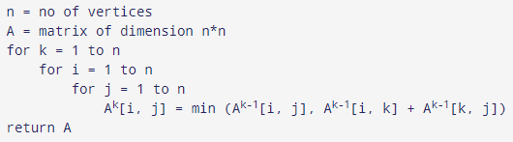
Algorithm

Slide 4
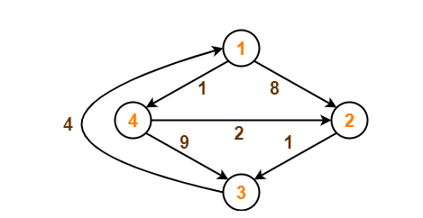
Example

Slide 5
Solution-
Step-0:
Remove all the self-loops and parallel edges (keeping the lowest weight edge) from the graph.
In the given graph, there are neither self-edges nor parallel edges.
Steps 1: Create a matrix D₀ of dimension n*n where n is the number of vertices.
Write the initial distance matrix.
It represents the distance between every pair of vertices in the form of given weights.
For diagonal elements (representing self-loops), distance value = 0.
For vertices having a direct edge between them, distance value = weight of that edge.
For vertices having no direct edge between them, distance value = ∞.

Slide 6
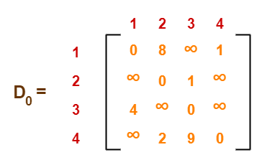

Slide 7
Step 2: Now, create a matrix D₁ using matrix D₀. The elements in the first column and the first row are left as they are. The remaining cells are filled in the following way. Let k be the intermediate vertex in the shortest path from source to destination. In this step, k is the first vertex.
D[i][j] is filled with (D[i][k] + D[k][j]) if (D[i][j] > D[i][k] + D[k][j]).

Slide 8
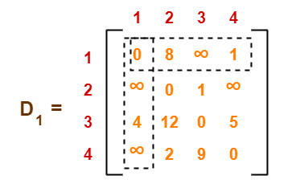

Slide 9
Step 3: In a similar way, D₂ is created using A₁. The elements in the second column and the second row are left as they are. In this step, k is the second vertex (i.e. vertex 2).

Slide 10
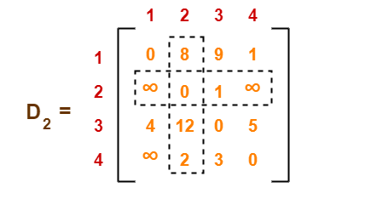

Slide 11
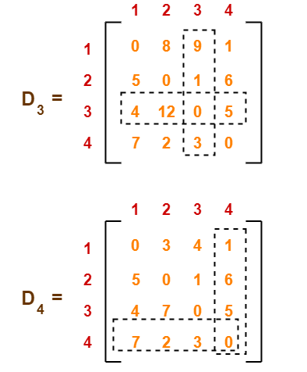
Step 4 and 5: Similarly, D₃ and D₄ is also created

Slide 12
The last matrix D₄ represents the shortest path distance between every pair of vertices. For example, from vertex 1 to vertex 4, cost is 1 and 1 to 3 is 4 and so on.

Slide 13
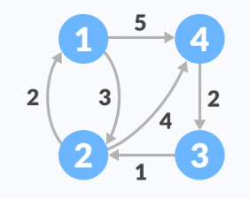
Find the shortest path between each pair of vertices.

